Slide 1
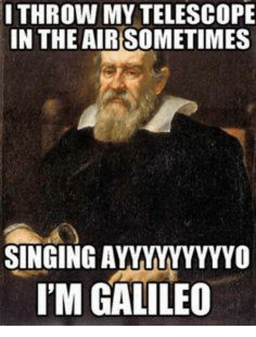
Space Technology Day 1
11/22
8ETS1.2

Slide 2
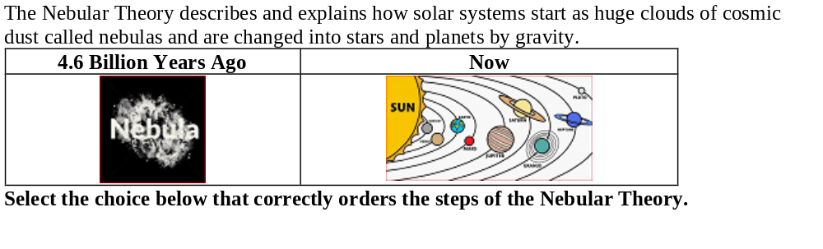
DQ
A. Step One: The Big Bang occurred resulting in the rapid expansion of our universe. Step Two: Solar systems began to form not long after the Big Bang. Step Three: Our solar system was the very first one to form. Step Four: Today, dark energy is pushing all other solar systems away from our sun.
B. Step One: Gravity pulled together atoms in a nebula into larger and larger clumps. Step Two: The largest clump of matter (mostly hydrogen) began to heat up. Step Three: Nuclear fusion occurred in this largest clump, and a star was formed. Step Four: Smaller clumps of matter around the star formed into planets.
8ETS1.2

Slide 3
Space Technologies Nearpod
Name of Technology | What is the technology used for? | How does it work? | Advantages and disadvantages
Telescope
Spectroscope
Satellites
Space Probes
1st period TN8BF
2nd period CRYDX
3rd period 5Y6PR
4th period GSH7C
6th period G3Q4L
7th period XNJ32
Complete the nearpod with the code for your class period. Fill in the table with information from the nearpod.
8ETS1.2

Slide 4
Complete the Celestial Observation Technology nearpod
1st period U3ATB
2nd period 5APUN
3rd period LCN45
4th period 9PB7Iv
6th period 8HBNA
7th period P5ATD
You may use the back of the Space Technologies paper to take notes for this nearpod.
8ETS1.2

